Slide 1
Affects of Gun Laws on Gun Crime

Slide 2
The Questions:
Does an increase in Gun Laws show a decrease in gun crimes?
Does population have an effect on Gun Crime?

Slide 3
Data Sources
Census Data
  Python Census library
  https://www.census.gov/data.html
Gun Crimes Data
  https://www.kaggle.com/jameslko/gun-violence-data
Gun Laws by State
  https://statefirearmlaws.org/resources

Slide 4
Data Limitations
Census Data
  Since the census has not been completed since 2010, the population numbers from 2014 – 2017 are estimated.
Gun Law Data
  No known restrictions, but are making the assumption the data is accurate
Gun Crimes
  Kaggle Data
  2013 is missing data, so dropped from overall analysis
  Assuming it is all encompassing, although seems a bit on the low side.

Slide 5
Analysis Process
Split the main data sources amongst group to do the initial cleanup and initial analysis
Reviewed the available data for gaps and communicate amongst team.
Combined the data to compare across datasets

Slide 6
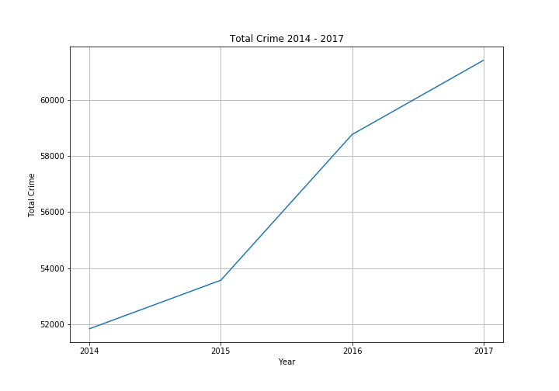
Crime Trend
The amount of crime is consistently rising over the years.

Slide 7
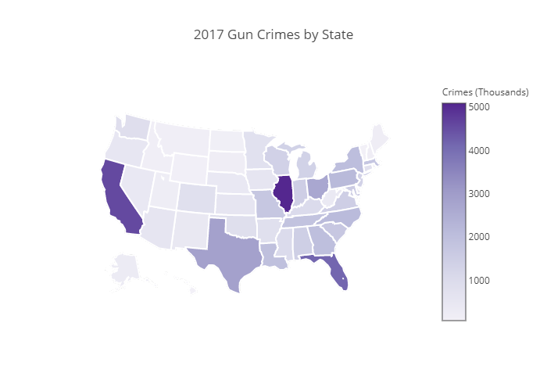
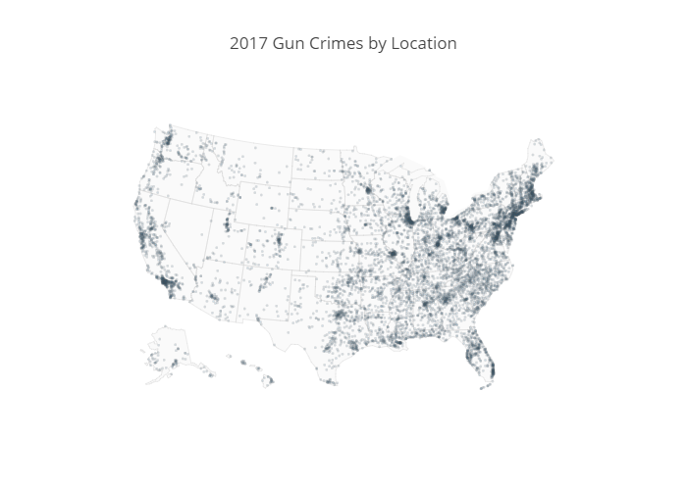
Crime by State in 2017
Observation: Illinois has the highest over amount of crime for 2017, but by location appears fairly sparse. This indicates most of the crime heavily concentrated in one or two locations.

Slide 8
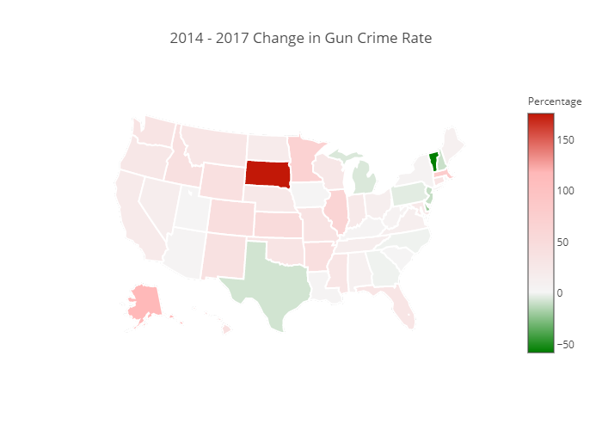
Change in Gun Crime between 2014-2017
Largest Increase
  South Dakota
  Alaska
  Massachusetts
Largest Decrease
  Vermont
  Delaware

Slide 9
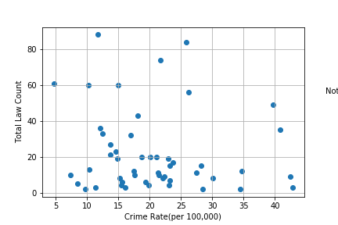
Law Count vs Crime per Capita 2017
Total Laws vs Crime Per Capita
There does not appear to be a correlation directly between number of laws and crimes per capita.
P-value is 0.39 which is insignificant

Slide 10
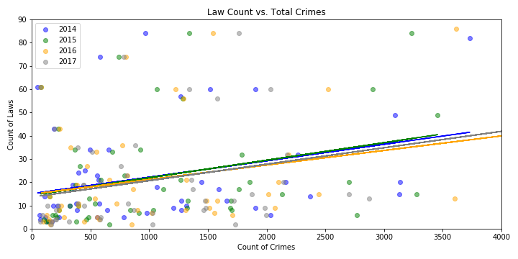
Law Count vs Total Crime 2014 - 2017
This shows as the number of crimes go up, so does the number of laws.
Is it the Chicken or Egg?

Slide 11
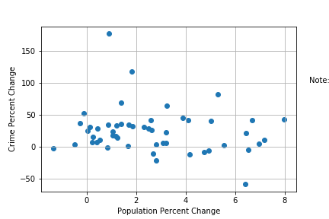
Population vs Gun Crime Cont.
Taking the rate of population change vs rate of crime change, we can see there is not a strong correlation between the two.
P-value is 0.29 which is insignificant

Slide 12
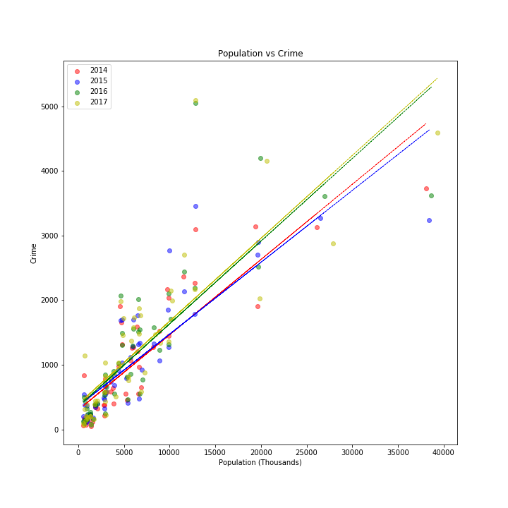
Population vs Gun Crime
In general, the higher the population, the higher the Gun Crimes
Between 2015 and 2016 there appears to be a trend of higher crime occurring at a lower population, based on trend lines.

Slide 13
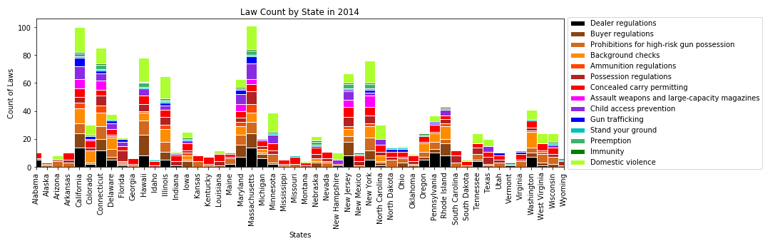

Gun Law Category by State and Year

Slide 14
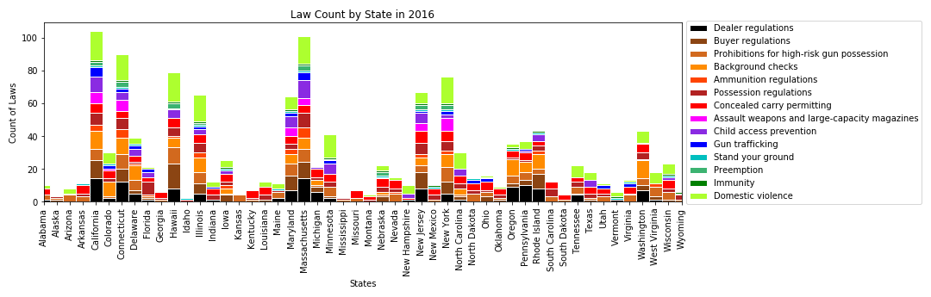
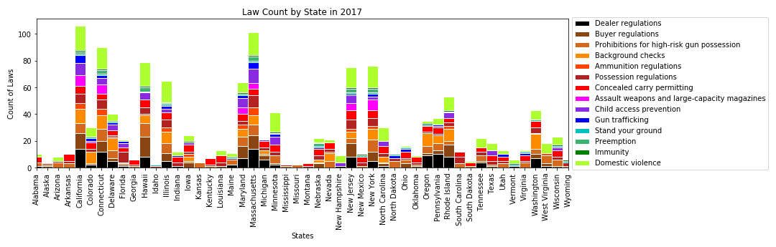
Gun Law Category by State and Year Cont.

Slide 15
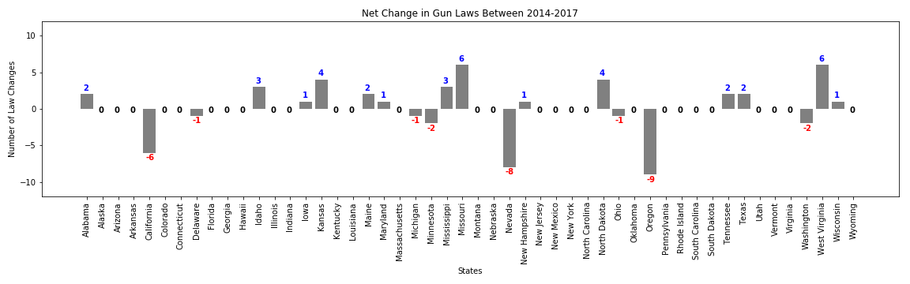
Gun Law Net Change

Slide 16
Hurdles
Had to change our scope early on due to what data we were readily able to find
Working with a large number of series (states) made it difficult to find the right visualizations
Had to adjust our assumptions/process
  Thought ranking/weighting laws would provide an insight, turned out to be more difficult to identify a weight by law type.
TOO MUCH DATA. There are many more available data points than what we had time to realistically analyze for trends.

Slide 17
Conclusion
We did not find a significant trend between the gun laws and the crime counts.
We did see as the population went up, so did the total crime, but this is to be expected, but the crime per capita did not change significantly.
With more time, we could look into gun ownership and income levels vs crime rates

